Slide 1




↘
Actor Model based on
Azure Service Bus
Mariusz Krzanowski
Senior Software Developer, SoftwareONE
www.WarszawskieDniInformatyki.pl
1-2 kwietnia 2022
Politechnika Warszawska + online
ORGANIZATOR GŁÓWNY:
KOMITET ORGANIZACYJNY: kilkadziesiąt organizacji z sektora IT / data science (pełna lista na stronie wydarzenia)

Slide 2

Actor Model based on Azure Service Bus
Think outside the broker box
Mariusz Krzanowski

Slide 3
Goals of the presentation
General overview of Actor Model
Inspiration of ‘alternative’ Azure Service Bus usage
How connecting the concepts of Message Broker and Actor Model can improve our applications
NOTE I’m trying to fit as much knowledge as possible here, but limited time is merciless😉

Slide 4


About ME
Employed in IT since year 0x7CF
Developer / Architect / Team Leader
Now: Senior Software Developer @ SoftwareONE
Experienced in many technologies
.NET, SQL, SharePoint, BizTalk, Google Cloud, Android, SCCM Active Directory, Microsoft Azure stack, Xamarin, Web … 23 years is long time ☺
I like to share my knowledge with others
You can meet me at Warszawska Grupa .NET (WG-NET)
I was presenting on Warszawskie Dni Informatyki

Slide 5
Azure Service Bus
Advanced message broker

Slide 6

Azure Service Bus
Publisher 1
Subscriber 1
Publisher 2
Subscriber 2
.
.
.
.
.
.
.
.
.
.
.
.
Publisher N
Subscriber N
NOTE: Minimum standard version of Azure Service Bus is required

Slide 7
Azure Service Bus – language
Topic – Like URI determines a category to which a message belongs.
Topic examples:
finance/invoices
finance/payments
Subscription - a logical endpoint for message retrieval
Single topic can have multiple subscriptions
Multiple processes can consume single subscription
Session - the logical way of clustering messages together
Session can be handled by a single process
Session creates a logical partition
Properties
Label/Subject: usually used to recognize payload type
Message ID: uniquely identifies message. Used by deduplication mechanism.

Slide 8
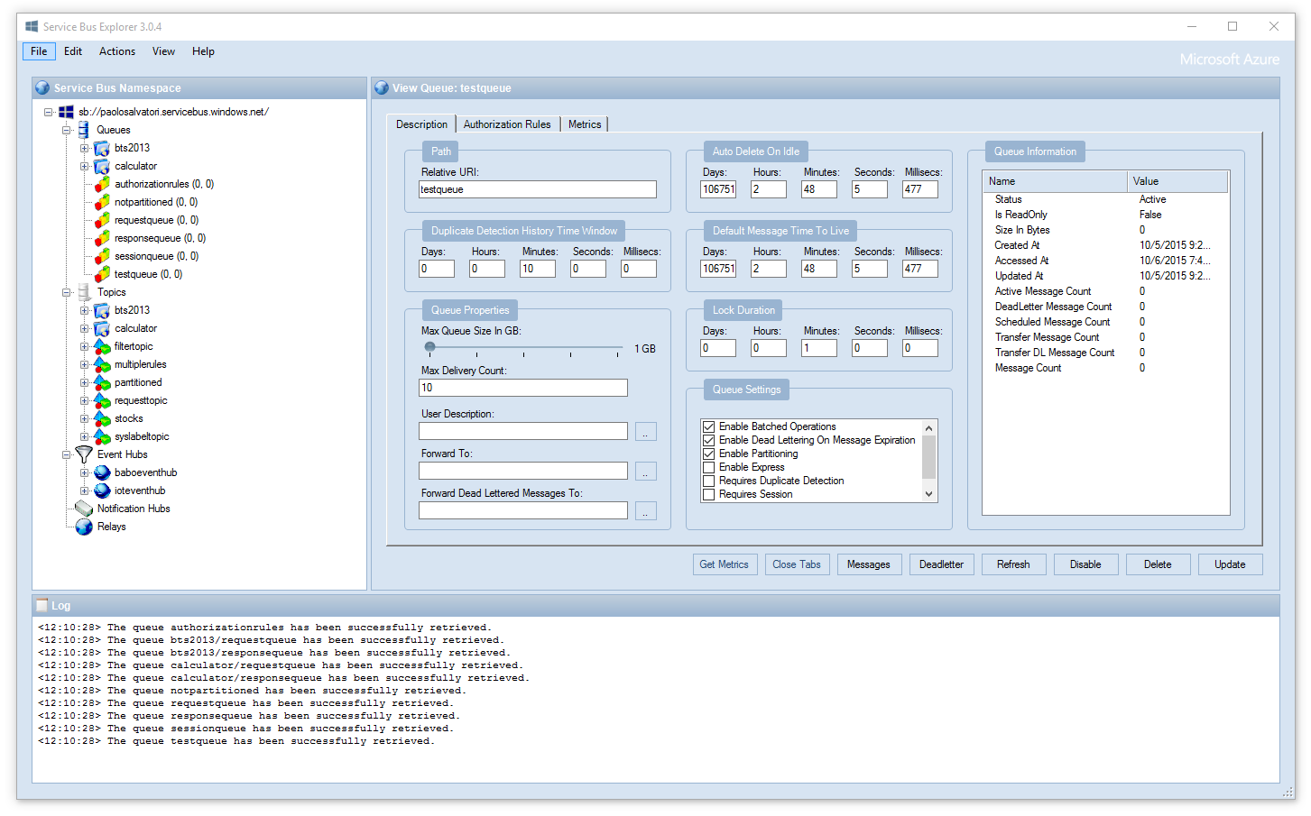
Service Bus Explorer
Source: https://github.com/paolosalvatori/ServiceBusExplorer

Slide 9
Actor Model

Slide 10





Actor Model
.
.
.
.
.
.
.
.
.
.
.
.
.
.
.
.
.
.

Slide 11
Actor Model – main concepts
Everything is an actor
Isolation
No direct access to another actor
Only actor modifies its state
Asynchronous communication
Communication via asynchronous messages only
‘Single thread’ per actor
No locks required
Actor can safely handle its own state
Actor Model is hierarchical
Parent creates or stops own children
Failure is handled by parent

Slide 12
Actor Model Roles
System
Logical representation of whole cluster
Supervisor
Parent should be responsible for its children
Router
Like in a cell phone network – we must deliver message to the actor

Slide 13
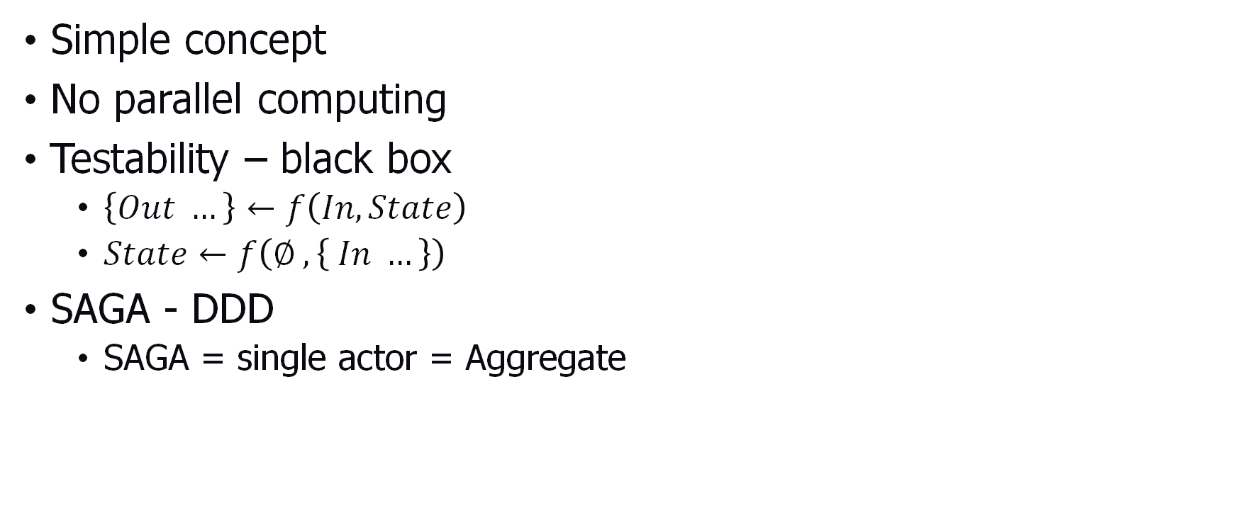
Actor Model - benefits
Simple concept
No parallel computing
Testability – black box
$\left\{Out …\right\}←f\left(In,State\right)$
$State←f\left(∅ , \left\{ In …\right\}\right)$
SAGA - DDD
SAGA = single actor = Aggregate

Slide 14
Cluster of Actors
Actor can run in any process
at any node of Actor System
No direct reference to other actors
Message simplifies message exchange
Actor Model does not guarantee consistency by default
State transition should be idempotent

Slide 15
How to adopt Bus
Azure Service Bus as an Actor Model?

Slide 16
Azure Service Bus is a message broker
Represents the whole communication layer of actor system
Represents message router
Can scale out to manage millions of actors

Slide 17
Azure Topic
Topic – Like URI determines a category to which a message belongs.
Hierarchy of topics can represent hierarchy of Actor types
Topic can be used as a part of Actor mail address

Slide 18
Azure Session
Session - the logical way of clustering messages together.
Single process can consume a single session
Session can represent single actor instance (consumer of messages)
Actor can rehydrate when session starts (state can travel with actor within cluster)
Session timeout
When actor dies it can resurrect on a different node

Slide 19
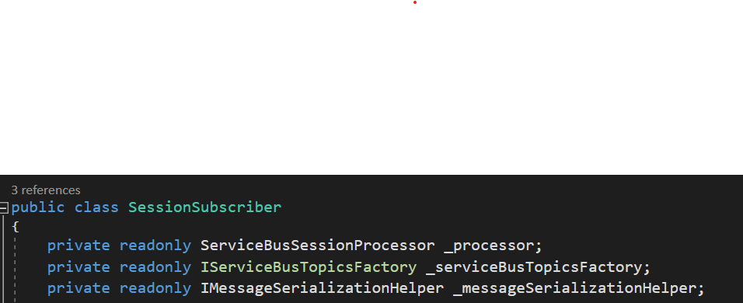
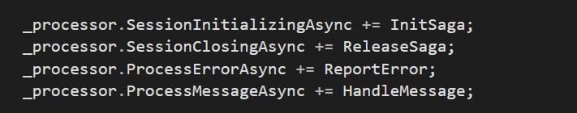
Actor lifecycle with Session

Slide 20
Actor Model data consistency - hints
Single message can be delivered multiple times.
Session guarantees message order, but consumer can fail
message goes to dead letter queue
Solution INBOX / OUTBOX pattern
Inbox stores information about processed input messages
Outbox stores information about messages not sent yet
Inbox, outbox and SAGA must be saved in single transaction boundary

Slide 21
DEMO
Let’s summarize our knowledge with a practical example

Slide 22
Samaritan
Let’s build an application that helps people in need. The application should collect information about Necessities. It should register Necessities and Donations and match both sets.

Slide 23
Samaritan – actors
Necessity Exchange
Donor
Necessity Exchange
Donor
Necessity Exchange
Donor
=> Donation
<= Need
👖 👕 👗 🧥
Necessitous
Necessitous
Necessitous
=> Need
<= Donation

Slide 24
Samaritan – actors vs REST API
Necessity Exchange
REST
API
‘PROXY’
Donor
Necessity Exchange
Donor
Necessity Exchange
Donor
=> Donation
<= Need
👖 👕 👗 🧥
Necessitous
Necessitous
Necessitous
=> Need
<= Donation

Slide 25
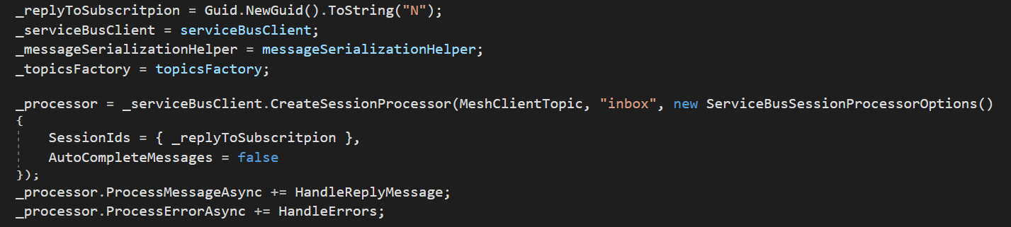
Service Bus – API : hint lock unique session Id
NOTE! Remember to set short TTL for messages

Slide 26
DEMO
Code in action

Slide 27
Reference
Service Bus Explorer – GitHub
https://github.com/paolosalvatori/ServiceBusExplorer
Azure Service Bus client library for .NET – GitHub
https://github.com/Azure/azure-sdk-for-net/blob/Azure.Messaging.ServiceBus_7.7.0/sdk/servicebus/Azure.Messaging.ServiceBus/README.md
When and How to Use the Actor Model An Introduction to Akka NET Actors
https://www.youtube.com/watch?v=0KnIMDoJpZs
Particular Software – YouTube
https://www.youtube.com/c/ParticularSoftware/videos
Petabridge – YouTube
https://www.youtube.com/c/PetabridgeAcademy/videos
CodeOpinion – YouTube
https://www.youtube.com/channel/UC3RKA4vunFAfrfxiJhPEplw/videos

Slide 28

Where can you find me?
Web
https://lastboardingcall.pl
https://mrmatrix.net
GitHub
https://github.com/MariuszKrzanowski
YouTube
Mariusz Krzanowski `mrmatrix.net`
Tweeter
@KrzanowskiM
Meetups
Warszawska Grupa .NET
Mariusz Krzanowski

Slide 29

Dziękujemy za oglądanie!
Zapraszamy do zadawania pytań
oraz oceny prelekcji pod nagraniem.
↘
www.WarszawskieDniInformatyki.pl
1-2 kwietnia 2022
Politechnika Warszawska + online
ORGANIZATOR GŁÓWNY:
KOMITET ORGANIZACYJNY: kilkadziesiąt organizacji z sektora IT / data science (pełna lista na stronie wydarzenia)

